Slide 1

Chapter 5
Peer-to-Peer Protocols and Data Link Layer
PART I: Peer-to-Peer Protocols
Peer-to-Peer Protocols
ARQ Protocols and Reliable Data Transfer
Flow Control
PART II: Data Link Controls
Framing
Point-to-Point Protocol
High-Level Data Link Control

Slide 2
Chapter 5
Peer-to-Peer Protocols and Data Link Layer
PART I: Peer-to-Peer Protocols
Peer-to-Peer Protocols
ARQ Protocols and Reliable Data Transfer
Flow Control

Slide 3
Peer-to-Peer protocols
Application
Application
Communicating End Systems
End-to-End Protocols
Application
Layer
Application
Layer
Transport
Layer
Transport
Layer
Network
Layer
Network
Layer
Network
Layer
Network
Layer
Data Link
Layer
Data Link
Layer
Data Link
Layer
Data Link
Layer
Physical
Layer
Physical
Layer
Physical
Layer
Physical
Layer
One or More Network Nodes

Slide 4
Reliability & Sequencing
Reliability: Are messages or information stream delivered error-free and without loss or duplication?
Sequencing: Are messages or information stream delivered in order?
ARQ protocols combine error detection, retransmission, and sequence numbering to provide reliability & sequencing
Examples: TCP and HDLC

Slide 5
End-to-End vs. Hop-by-Hop
A service feature can be provided by implementing a protocol
  end-to-end across the network
  across every hop in the network
Example:
  Perform error control at every hop in the network or only between the source and destination?
  Perform flow control between every hop in the network or only between source & destination?
We next consider the tradeoffs between the two approaches

Slide 6
Error control in Data Link Layer
Packets
Packets
Data Link operates over wire-like, directly-connected systems
Frames can be corrupted or lost, but arrive in order
Data link performs error-checking & retransmission
Ensures error-free packet transfer between two systems
(a)
Data link
layer
Data link
layer
A
Frames
Physical
layer
B
Physical
layer
(b)
1
1
2
2
1
2
3
2
1
1
2
3
2
1
Medium
2
A
B
1
1
Physical layer entity
2
Data link layer entity
3
Network layer entity

Slide 7
Error Control in Transport Layer
Transport layer protocol (e.g. TCP) sends segments across network and performs end-to-end error checking & retransmission
Underlying network is assumed to be unreliable
Messages
Messages
Transport
layer
Segments
Transport
layer
Network
layer
Network
layer
Network
layer
Network
layer
Data link
layer
Data link
layer
Data link
layer
Data link
layer
End system
A
End system
B
Physical
layer
Physical
layer
Physical
layer
Physical
layer
Network

Slide 8
Segments can experience long delays, can be lost, or arrive out-of-order because packets can follow different paths across network
End-to-end error control protocol more difficult
1
2
3
2
1
C
2
2
1
1
End System
α
1
1
End System
β
1
2
2
2
4
3
2
1
1
2
3
2
1
1
2
3
2
1
1
2
3
4
Medium
2
A
B
1
Network
3
Network layer entity
4
Transport layer entity

Slide 9
Comparisons
Hop-by-hop
Data
Data
Data
Data
1
2
3
4
5
Faster recovery
ACK/NAK
ACK/NAK
ACK/NAK
ACK/NAK
Simple inside the network
End-to-end
ACK/NAK
More scalable, complexity at the edge
1
2
3
4
5
Data
Data
Data
Data

Slide 10
Chapter 5
Peer-to-Peer Protocols and Data Link Layer
PART I: Peer-to-Peer Protocols
Peer-to-Peer Protocols
ARQ Protocols and Reliable Data Transfer
Flow Control

Slide 11
Error Control
Digital transmission systems introduce errors
Applications require certain reliability level
  Data applications require error-free transfer
  Voice & video applications tolerate some errors
Error control used when transmission system does not meet application requirement
Error control ensures a data stream is transmitted to a certain level of accuracy despite errors
Two basic approaches:
  Error detection & retransmission (ARQ)
  Forward error correction (FEC) (not covered in this course)

Slide 12
Error Detection
(This topic is covered in Chapter 3 of the book)

Slide 13
Key Idea of Error Detection
All transmitted data blocks (“codewords”) satisfy a pattern
If received block doesn’t satisfy pattern, it is in error
Redundancy: Only a subset of all possible blocks can be codewords, eg, data block length=2 bits, 1 bit redundancy:
x
coding
x
x
x = codewords
o = noncodewords
x
0
0
0
0
2-bit data blocks
2-bit data, 1 bit redundancy

Slide 14
Blindspot: when channel transforms a codeword into another codeword
All inputs to channel
satisfy pattern or condition
Channel
output
Deliver user
information or
set error alarm
User
information
Encoder
Channel
Pattern
checking

Slide 15
Single Parity Check
Append an overall parity check to k information bits
Info Bits: b₁, b₂, b₃, …, b_{k}
Check Bit: b_{k+1}= b₁+ b₂+ b₃+ …+ b_{k} modulo 2
Codeword: (b₁, b₂, b₃, …, b_{k,}, b_{k+1})
All codewords have even # of 1s
Receiver checks to see if # of 1s is even
  All error patterns that change an odd # of bits are detectable
  All even-numbered patterns are undetectable
Parity bit used in ASCII code

Slide 16
Example of Single Parity Code
Information (7 bits): (0, 1, 0, 1, 1, 0, 0)
Parity Bit: b₈ = 0 + 1 +0 + 1 +1 + 0 = 1
Codeword (8 bits): (0, 1, 0, 1, 1, 0, 0, 1)
If single error in bit 3 : (0, 1, 1, 1, 1, 0, 0, 1)
  # of 1’s =5, odd
  Error detected
If errors in bits 3 and 5: (0, 1, 1, 1, 0, 0, 0, 1)
  # of 1’s =4, even
  Error not detected

Slide 17
Checkbits & Error Detection
Information bits
Received information bits
Recalculate check bits
k bits
Channel
Calculate check bits
Compare
Sent check
bits
Received check bits
Information accepted if check bits match
n – k bits

Slide 18
How good is the single parity check code?
Redundancy: Single parity check code adds 1 redundant bit per k information bits: overhead = 1/(k + 1)
Coverage: all error patterns with odd # of errors can be detected
  An error pattern is a binary (k + 1)-tuple with 1s where errors occur and 0’s elsewhere
  Of 2^{k+1} binary (k + 1)-tuples, ½ are odd, so 50% of error patterns can be detected
Is it possible to detect more errors if we add more check bits?
Yes, with the right codes

Slide 19
What if bit errors are random?
Many transmission channels introduce bit errors at random, independently of each other, and with probability p
Some error patterns are more probable than others:
p
1 – p
P[10000000] = p(1 – p)⁷ = (1 – p)⁸ and
P[11000000] = p²(1 – p)⁶ = (1 – p)⁸
p ²
1 – p
In any worthwhile channel p < 0.5, and so (p/(1 – p)) < 1
It follows that patterns with 1 error are more likely than patterns with 2 errors and so forth
What is the probability that an undetectable error pattern occurs?

Slide 20
Single parity check code with random bit errors
Undetectable error pattern if even # of bit errors:
P[error detection failure] = P[undetectable error pattern]
= P[error patterns with even number of 1s]
= p²(1 – p)^{n-2} + p⁴(1 – p)^{n-4} + …
n
2
n
4
Example: Evaluate above for n = 32, p = 10⁻³
32
2
32
4
P[undetectable error] = (10⁻³)² (1 – 10⁻³)³⁰ + (10⁻³)⁴ (1 – 10⁻³)²⁸
≈ 496 (10⁻⁶) + 35960 (10⁻¹²) ≈ 4.96 (10⁻⁴)
For this example, roughly 1 in 2000 error patterns is undetectable

Slide 21
What is a good code?
Many channels have preference for error patterns that have fewer # of errors
These error patterns map transmitted codeword to nearby n-tuple
If codewords close to each other then detection failures will occur
Good codes should maximize separation between codewords
o
o
o
x
o
x
Poor
distance properties
x
x
x
o
o
o
x
x
o
o
o
o
o
x = codewords
o = noncodewords
o
x
o
x
o
o
o
Good
distance properties
x
o
x
o
x
o
o
o
x
o
x
o

Slide 22
Two-Dimensional Parity Check
More parity bits to improve coverage
Arrange information as columns
Add single parity bit to each column
Add a final “parity” column
Used in early error control systems
1 0 0 1 0 0
0 1 0 0 0 1
1 0 0 1 0 0
1 1 0 1 1 0
1 0 0 1 1 1
Last column consists of check bits for each row
Bottom row consists of check bit for each column

Slide 23
Error-detecting capability
1 0 0 1 0 0
0 0 0 0 0 1
1 0 0 1 0 0
1 1 0 1 1 0
1 0 0 1 1 1
1 0 0 1 0 0
0 0 0 0 0 1
1 0 0 1 0 0
1 0 0 1 1 0
1 0 0 1 1 1
One error
Two errors
1, 2, or 3 errors can always be detected; Not all patterns >4 errors can be detected
1 0 0 1 0 0
0 0 0 1 0 1
1 0 0 1 0 0
1 0 0 1 1 0
1 0 0 1 1 1
1 0 0 1 0 0
0 0 0 1 0 1
1 0 0 1 0 0
1 0 0 0 1 0
1 0 0 1 1 1
Three errors
Four errors (undetectable)
Arrows indicate failed check bits

Slide 24
Other Error Detection Codes
Many applications require very low error rate
Need codes that detect the vast majority of errors
Single parity check codes do not detect enough errors
Two-dimensional codes require too many check bits
The following error detecting codes used in practice:
  Internet Check Sums
  CRC Polynomial Codes

Slide 25
Internet Checksum
0 4 8 16 19 24 31
Version IHL Type of Service Total Length
Identification Flags Fragment Offset
Time to Live Protocol Header Checksum
Source IP Address
Destination IP Address
Options Padding
how to calculate this?

Slide 26
Internet Checksum
Several Internet protocols (e.g. IP, TCP, UDP) use check bits to detect errors in the IP header (or in the header and data for TCP/UDP)
A checksum is calculated for header contents and included in a special field.
Checksum recalculated at every router, so algorithm selected for ease of implementation in software
Let header consist of L, 16-bit words,
  b₀, b₁, b₂, ..., b_{L-1}
The algorithm appends a 16-bit checksum b_{L}

Slide 27
Checksum Calculation
The checksum b_{L} is calculated as follows:
Treating each 16-bit word as an integer, find
x = b₀ + b₁ + b₂+ ...+ b_{L-1} modulo 2¹⁶-1
The checksum is then given by:
b_{L} = - x modulo 2¹⁶-1
Thus, the headers must satisfy the following pattern:
0 = b₀ + b₁ + b₂+ ...+ b_{L-1} + b_{L} modulo 2¹⁶-1
The checksum calculation is carried out in software using one’s complement arithmetic

Slide 28
Internet Checksum Example
For simplicity, assuming 4-bit words
Use Binary Arithmetic
Note 16 =1 mod15
So: 10000 = 0001 mod15
leading bit wraps around
Use Modulo Arithmetic
Use mod 2⁴-1 arithmetic
b₀=1100 = 12
b₁=1010 = 10
b₀+b₁=12+10=7 mod15
b₂ = -7 = 8 mod15
Therefore
b₂=1000
b₀ + b₁ = 1100+1010
=10110
=10000+0110
=0001+0110
=0111
=7
Take 1s complement
b₂ = -0111 =1000

Slide 29
Polynomial Codes
Polynomials instead of vectors for codewords
Polynomial arithmetic instead of check sums
Implemented using shift-register circuits
Also called cyclic redundancy check (CRC) codes
Most data communications standards use polynomial codes for error detection
Polynomial codes also basis for powerful error-correction methods

Slide 30
Binary Polynomial Arithmetic
Binary vectors map to polynomials
(i_{k-1} , i_{k-2} ,…, i₂ , i₁ , i₀) → i_{k-1}x^{k-1} + i_{k-2}x^{k-2} + … + i₂x² + i₁x + i₀
Addition:
(x⁷ + x⁶ + 1) + (x⁶ + x⁵) = x⁷ + x⁶ + x⁶ + x⁵ + 1
= x⁷ +(1+1)x⁶ + x⁵ + 1
= x⁷ +x⁵ + 1 since 1+1=0 mod2
Multiplication:
(x + 1) (x² + x + 1) = x(x² + x + 1) + 1(x² + x + 1)
= (x³ + x² + x) + (x² + x + 1)
= x³ + 1

Slide 31
Binary Polynomial Division
Division with Decimal Numbers
4
3
quotient
dividend = quotient x divisor +remainder
35 ) 1222
dividend
105
1222 = 34 x 35 + 32
divisor
2
17
140
32
remainder
Polynomial Division
x³
+ x²
+ x
= q(x) quotient
x³ + x + 1 ) x⁶ + x⁵
x⁶ + x⁴ + x³
dividend
divisor
x⁵ + x⁴ + x³
x⁵ + x³ + x²
Note: Degree of r(x) is less than degree of divisor
x⁴ + x²
x⁴ + x² + x
x
= r(x) remainder

Slide 32
Polynomial Coding
Code has binary generating polynomial of degree n–k
g(x) = x^{n-k} + g_{n-k-1}x^{n-k-1} + … + g₂x² + g₁x + 1
k information bits define polynomial of degree k – 1
i(x) = i_{k-1}x^{k-1} + i_{k-2}x^{k-2} + … + i₂x² + i₁x + i₀
Find remainder polynomial of at most degree n – k – 1
q(x)
g(x) ) x^{n-k} i(x)
x^{n-k}i(x) = q(x)g(x) + r(x)
r(x)
Define the codeword polynomial of degree n – 1
b(x) = x^{n-k}i(x) + r(x)
n bits
k bits
n-k bits

Slide 33
Polynomial example: k = 4, n–k = 3
Generator polynomial: g(x)= x³ + x + 1
Information: (1,1,0,0) i(x) = x³ + x²
Encoding: x³i(x) = x⁶ + x⁵
x³ + x² + x
1110
x³ + x + 1 ) x⁶ + x⁵
1011 ) 1100000
x⁶ + x⁴ + x³
1011
x⁵ + x⁴ + x³
1110
x⁵ + x³ + x²
1011
x⁴ + x²
1010
x⁴ + x² + x
1011
x
010
Transmitted codeword:
      b(x) = x⁶ + x⁵ + x
      b = (1,1,0,0,0,1,0)

Slide 34
The Pattern in Polynomial Coding
All codewords satisfy the following pattern:
b(x) = x^{n-k}i(x) + r(x) = q(x)g(x) + r(x) + r(x) = q(x)g(x)
All codewords are a multiple of g(x)!
Receiver should divide received n-tuple by g(x) and check if remainder is zero
If remainder is nonzero, then received n-tuple is not a codeword

Slide 35
Shift-Register Implementation
Accept information bits i_{k-1},i_{k-2},…,i₂,i₁,i₀
Append n – k zeros to information bits
Feed sequence to shift-register circuit that performs polynomial division
After n shifts, the shift register contains the remainder

Slide 36
Division Circuit
Encoder for g(x) = x³ + x + 1
0,0,0,i₀,i₁,i₂,i₃
g₀ = 1
g₁ = 1
g₃ = 1
+
Reg 0
+
Reg 1
Reg 2
Clock Input Reg 0 Reg 1 Reg 2
0 - 0 0 0
1 1 = i₃ 1 0 0
2 1 = i₂ 1 1 0
3 0 = i₁ 0 1 1
4 0 = i₀ 1 1 1
5 0 1 0 1
6 0 1 0 0
7 0 0 1 0 Check bits: r₀ = 0 r₁ = 1 r₂ = 0
r(x) = x
Notes:
Just before clock 1 signal arrives, input bit (i_3) =1 , Reg 0 =0, Reg 1 = 0, Reg 2 = 0. And note that value of Reg 2 is feedback to the exclusive OR gate before Reg 0 (let it be Gate 0), and to the exclusive gate before Reg 1 (let it be Gate 1). So, with i_3 =1 as the other input of Gate 0, the output of Gate 0 is 1 (which is input of Reg 0), and output of Gate 1 is 0
When clock 1 signal is generated, input of each shift register becomes output, so Reg 0 = 1, Reg 1 = 0 and Reg 2 = 0. At this moment, input bit is 1 (i_2), feedback from Reg 2 = 0, so output of Gate 0 =1. Similarly, output of Gate 1 = 1
When clock 2 signal is generated, again, input of each shift register becomes output, so Reg 0 = 1, Reg 1 = 1 and Reg 2 = 0. At this moment, input bit is 1 (i_1), feedback from Reg 2 = 0, so output of Gate 0 =0. Similarly, output of Gate 1 = 1
Continuing in this manner, after clock 7, reg 0 =0, Reg 1 = 1, and Reg 2 = 0

Slide 37
Undetectable error patterns
(Transmitter)
(Receiver)
b(x)
+
R(x)=b(x)+e(x)
(Channel)
  e(x)
Error polynomial
e(x) has 1s in error locations & 0s elsewhere
Receiver divides the received polynomial R(x) by g(x)
Blindspot: If e(x) is a multiple of g(x), that is, e(x) is a nonzero codeword, then
R(x) = b(x) + e(x) = q(x)g(x) + q’(x)g(x)
The set of undetectable error polynomials is the set of nonzero code polynomials
Choose the generator polynomial so that selected error patterns can be detected.

Slide 38
Designing good polynomial codes
Select generator polynomial so that likely error patterns are not multiples of g(x)
Detecting Single Errors
  e(x) = x^{i} for error in location i + 1
  If g(x) has more than 1 term, it cannot divide x^{i}
Detecting Double Errors
  e(x) = x^{i} + x^{j} = x^{i}(x^{j-i}+1) where j>i
  If g(x) has more than 1 term, it cannot divide x^{i}
  If g(x) is a primitive polynomial, it cannot divide x^{m}+1 for all m<2^{n-k}-1 (Need to keep codeword length less than 2^{n-k}-1)
  Primitive polynomials can be found by consulting coding theory books

Slide 39
Designing good polynomial codes
Detecting Odd Numbers of Errors
  For odd number of errors, e(x) evaluated at x = 1 is 1, therefore (x+1) is not a factor of e(x)
  Suppose all codeword polynomials have an even # of 1s, b(x) evaluated at x = 1 is zero because b(x) has an even number of 1s
  This implies x + 1 must be a factor of all b(x)
  Pick g(x) = (x + 1) p(x) where p(x) is primitive

Slide 40
Standard Generator Polynomials
CRC = cyclic redundancy check
CRC-8:
CRC-16:
CCITT-16:
CCITT-32:
ATM
= x⁸ + x² + x + 1
Bisync
= x¹⁶ + x¹⁵ + x² + 1
= (x + 1)(x¹⁵ + x + 1)
HDLC, XMODEM, V.41
= x¹⁶ + x¹² + x⁵ + 1
IEEE 802, DoD, V.42
= x³² + x²⁶ + x²³ + x²² + x¹⁶ + x¹² + x¹¹ + x¹⁰ + x⁸ + x⁷ + x⁵ + x⁴ + x² + x + 1

Slide 41
Error Control
Two basic approaches:
  Error detection & retransmission (ARQ)
  Forward error correction (FEC)

Slide 42
Automatic Repeat Request (ARQ)
Purpose: to ensure a sequence of information packets is delivered in order and without errors or duplications despite transmission errors & losses
We will look at:
  Stop-and-Wait ARQ
  Go-Back N ARQ
  Selective Repeat ARQ
Basic elements of ARQ:
  Error-detecting code with high error coverage
  ACKs (positive acknowledgments)
  NAKs (negative acknowlegments)
  Timeout mechanism

Slide 43
Stop-and-Wait ARQ
Transmit a frame, wait for ACK
Packet
Error-free
packet
Information frame
Transmitter
(Process A)
Receiver
(Process B)
Timer set after each frame transmission
Control frame
Header
CRC
Information
packet
Header
CRC
Information frame
Control frame: ACKs

Slide 44
Need for Sequence Numbers
(a) Frame 1 lost
Time-out
Time
A
Frame
0
Frame
1
Frame
1
Frame
2
B
ACK
ACK
(b) ACK lost
Time-out
Time
A
Frame
0
Frame
1
Frame
1
Frame
2
ACK
ACK
ACK
B
  In cases (a) & (b) the transmitting station A acts the same way
  But in case (b) the receiving station B accepts frame 1 twice
  Question: How is the receiver to know the second frame is also frame 1?
  Answer: Add frame sequence number in header
  S_{last} is sequence number of most recent transmitted frame

Slide 45
Sequence Numbers
(c) Premature Time-out
Time-out
Time
A
Frame
0
Frame
0
Frame
1
Frame
2
ACK
ACK
B
  The transmitting station A misinterprets duplicate ACKs
  Incorrectly assumes second ACK acknowledges Frame 1
  Question: How is the transmitter to know second ACK is for frame 0?
  Answer: Add frame sequence number in ACK header
  R_{next} is sequence number of next frame expected by the receiver
  Implicitly acknowledges receipt of all prior frames

Slide 46
1-Bit Sequence Numbering Suffices
0 1
0 1
0 1
0 1
0 1
0 1
0 1
0 1
S_{last}
R_{next}
Timer
Transmitter A
S_{last}
Receiver B
R_{next}
Global State:
(S_{last}, R_{next})
Error-free frame 0
arrives at receiver
(0,0)
(0,1)
ACK for
frame 0
arrives at
transmitter
ACK for
frame 1
arrives at
transmitter
Error-free frame 1
arrives at receiver
(1,0)
(1,1)

Slide 47
Stop-and-Wait ARQ
Transmitter
Ready state
Await request from higher layer for packet transfer
When request arrives, transmit frame with updated S_{last} and CRC
Go to Wait State
Wait state
Wait for ACK or timer to expire; block requests from higher layer
If timeout expires
  retransmit frame and reset timer
If ACK received:
  If sequence number is incorrect or if errors detected: ignore ACK
  If sequence number is correct (R_{next} = S_{last} +1): accept frame, go to Ready state
Receiver
Always in Ready State
Wait for arrival of new frame
When frame arrives, check for errors
If no errors detected and sequence number is correct (S_{last}=R_{next}), then
  accept frame,
  update R_{next},
  send ACK frame with R_{next},
  deliver packet to higher layer
If no errors detected and wrong sequence number
  discard frame
  send ACK frame with R_{next}
If errors detected
  discard frame

Slide 48
Applications of Stop-and-Wait ARQ
IBM Binary Synchronous Communications protocol (Bisync): character-oriented data link control
Xmodem: modem file transfer protocol
Trivial File Transfer Protocol (RFC 1350): simple protocol for file transfer over UDP

Slide 49
Stop-and-Wait Efficiency
Last frame bit enters channel
ACK arrives
First frame bit enters channel
Channel idle while transmitter waits for ACK
t
A
B
t
First frame bit arrives at receiver
Receiver processes frame and
prepares ACK
Last frame bit arrives at receiver
10000 bit frame @ 1 Mbps takes 10 ms to transmit
If wait for ACK = 1 ms, then efficiency = 10/11= 91%
If wait for ACK = 20 ms, then efficiency =10/30 = 33%

Slide 50
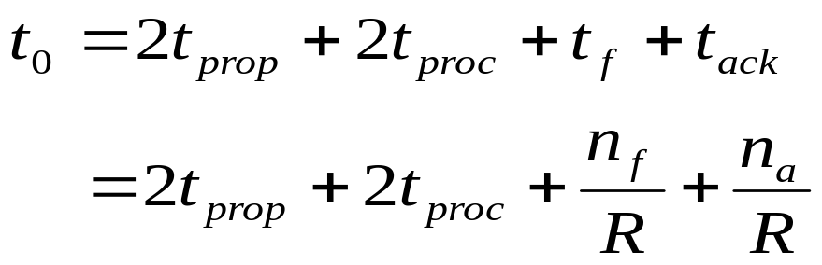
Stop-and-Wait Model
      t₀ = total time to transmit 1 frame
A
t_{proc}
B
t_{prop}
frame
t_{f} time
t_{proc}
t_{ack}
t_{prop}
bits/info frame
bits/ACK frame
channel transmission rate

Slide 51
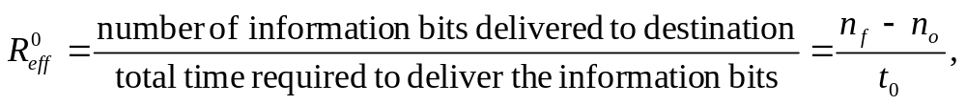
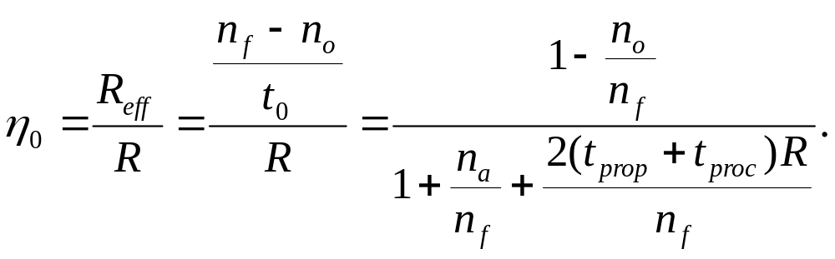
S&W Efficiency on Error-free channel
Effective transmission rate:
bits for header & CRC
Transmission efficiency:
Effect of
frame overhead
Effect of
Delay-Bandwidth Product
Effect of
ACK frame

Slide 52
Example: Impact of Delay-Bandwidth Product
n_{f}=1250 bytes = 10000 bits, n_{a}=n_{o}=25 bytes = 200 bits
2xDelayxBW Efficiency | 1 ms 200 km | 10 ms 2000 km | 100 ms 20000 km | 1 sec 200000 km
1 Mbps | 10³ 88% | 10⁴ 49% | 10⁵ 9% | 10⁶ 1%
1 Gbps | 10⁶ 1% | 10⁷ 0.1% | 10⁸ 0.01% | 10⁹ 0.001%
Stop-and-Wait does not work well for very high speeds or long propagation delays

Slide 53
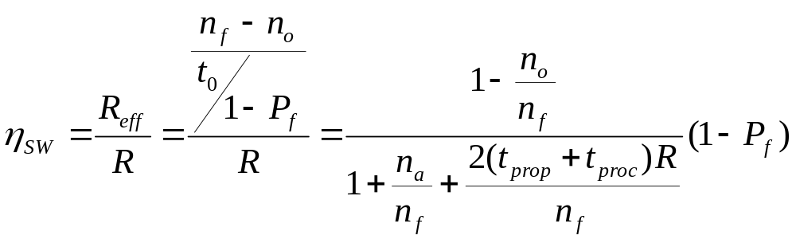
S&W Efficiency in Channel with Errors
Let 1 – P_{f} = probability frame arrives w/o errors
Avg. # of transmissions to first correct arrival is then 1/ (1–P_{f} )
“If 1-in-10 get through without error, then avg. 10 tries to success”
Avg. Total Time per frame is then t₀/(1 – P_{f}) (a proper derivation is given in next two slides)
Effect of frame loss

Slide 54
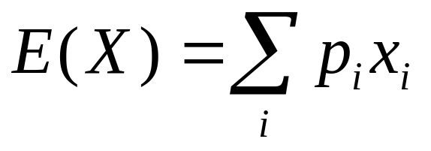
Just-in-time mathematics
Let X be a random variable assuming the values of x₁, x₂,… with corresponding probabilities p₁, p₂,.... The mean or expected value of X is defined by:
eg: x₁=1, x₂=2, x₃ =3, each with probability of 1/3
E(X ) = 1/3 + 2/3 + 3/3 = (1+2+3)/3 =2, which is the simple average formula when X takes each value with equal probability

Slide 55
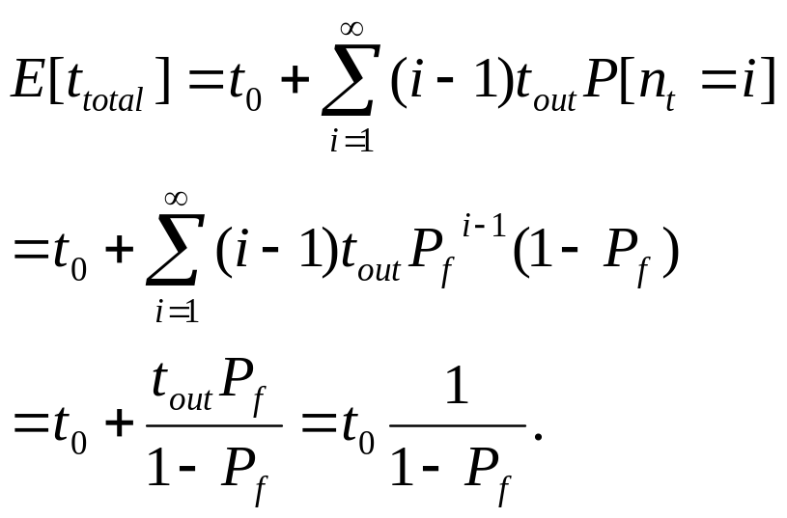
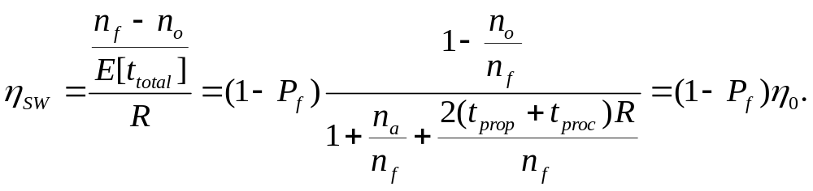
Stop & Wait Performance
1 successful transmission
i – 1 unsuccessful transmissions
Efficiency:

Slide 56
Example: Impact Bit Error Rate
n_{f}=1250 bytes = 10000 bits, n_{a}=n_{o}=25 bytes = 200 bits
Find efficiency for random bit errors with p=0, 10⁻⁶, 10⁻⁵, 10⁻⁴
1 – P_{f} Efficiency | 0 | 10⁻⁶ | 10⁻⁵ | 10⁻⁴
1 Mbps & 1 ms | 1 88% | 0.99 86.6% | 0.905 79.2% | 0.368 32.2%
Bit errors impact performance as n_{f}p approach 1

Slide 57
Go-Back-N
Improve Stop-and-Wait by not waiting!
Keep channel busy by continuing to send frames
Allow a window of up to W_{s} outstanding frames
Use m-bit sequence numbering
Primitive version
  If ACK for oldest frame arrives before window is exhausted, we can continue transmitting
  If window is exhausted, pull back and retransmit all outstanding frames
Alternative: Use timeout

Slide 58
Go-Back-N ARQ (primitive version)
Go-Back-4:
4 frames are outstanding; so go back 4
fr
0
fr
1
fr
2
fr
3
fr
4
fr
5
fr
6
fr
3
fr
4
fr
5
fr
6
fr
7
fr
8
fr
9
Time
A
B
ACK1
ACK2
ACK3
out of sequence frames
ACK4
ACK5
ACK6
ACK7
ACK8
ACK9
R_{next} 0 1 2 3 3 4 5 6 7 8 9
  Frame transmission are pipelined to keep the channel busy
  Frame with errors and subsequent out-of-sequence frames are ignored
  Transmitter is forced to go back when window of 4 is exhausted

Slide 59
Window size long enough to cover round trip time
Time-out expires
Stop-and-Wait ARQ
Time
fr
0
fr
0
fr
1
A
B
Receiver is looking for R_{next}=0
ACK1
Go-Back-N ARQ
Four frames are outstanding; so go back 4
fr
0
fr
1
fr
2
fr
3
fr
0
fr
1
fr
2
fr
3
fr
4
fr
5
fr
6
Time
A
B
Receiver is looking for R_{next}=0
Out-of-sequence frames
ACK1
ACK2
ACK3
ACK4
ACK5
ACK6

Slide 60
Go-Back-N (with timeout)
Problem with the primitive Go-Back-N as presented:
  If frame is lost and source does not have frame to send, then window will not be exhausted and recovery will not commence
Use a timeout with each frame
  When timeout expires, resend all outstanding frames

Slide 61
Go-Back-N Transmitter & Receiver
Transmitter
Receiver
Send Window
Receive Window
...
Frames
transmitted
and ACKed
S_{last}
S_{recent}
S_{last}+W_{s}-1
Buffers
Frames
received
R_{next}
oldest un-ACKed frame
Timer
S_{last}
Timer
S_{last}+1
Receiver will only accept
a frame that is error-free and
that has sequence number R_{next}
When such frame arrives R_{next} is incremented by one, so the receive window slides forward by one
...
S_{recent}
most recent transmission
Timer
...
S_{last}+W_{s}-1
max Seq # allowed

Slide 62
Sliding Window Operation
Transmitter
Send Window
m-bit Sequence Numbering
...
Frames
transmitted
and ACKed
0
S_{last}
S_{recent}
S_{last}+W_{s}-1
2^{m} – 1
1
2
Transmitter waits for error-free ACK frame with sequence number S_{last}
When such ACK frame arrives, S_{last} is incremented by one, and the send window slides forward by one
S_{last}
send
window
i
i + W_{s} – 1
i + 1

Slide 63
Maximum Allowable Window Size is W_{s} = 2^{m}-1
M = 2² = 4, Go-Back - 4:
Transmitter goes back 4
fr
0
fr
1
fr
2
fr
3
fr
0
fr
1
fr
2
fr
3
Time
A
B
ACK1
ACK2
ACK3
ACK
0
Receiver has R_{next}= 0, but it does not know whether its ACK for frame 0 was received, so it does not know whether this is the old frame 0 or a new frame 0
R_{next} 0 1 2 3 0
M = 2² = 4, Go-Back-3:
Transmitter goes back 3
fr
0
fr
1
fr
2
fr
0
fr
1
fr
2
Time
A
B
ACK1
ACK2
ACK3
Receiver has R_{next}= 3 , so it rejects the old frame 0
R_{next} 0 1 2 3

Slide 64
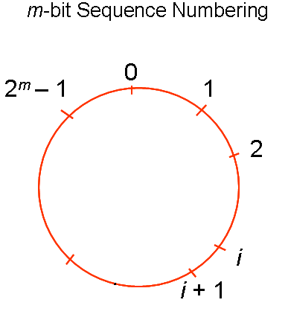
Another View
S_{last}
SEND WINDOW
SEND WINDOW
SEND WINDOW
SEND WINDOW

Slide 65
ACK Piggybacking in Bidirectional GBN
Transmitter
S^{A}_{recent} R^{A} _{next}
Receiver
Receiver
Transmitter
S^{B}_{recent} R^{B} _{next}
“A” Receive Window
“B” Receive Window
R^{A} _{next}
R^{B} _{next}
“A” Send Window
“B” Send Window
...
...
S^{A} _{last}
S^{A} _{last}+W^{A} _{s}-1
S^{B} _{last}
S^{B} _{last}+W^{B} _{s}-1
Buffers
Buffers
Timer
S^{A} _{last}
Timer
S^{B} _{last}
Timer
S^{A} _{last}+1
Note: Out-of-sequence error-free frames discarded after R_{next} examined
Timer
S^{B}_{last}+1
...
...
Timer
S^{A}_{recent}
Timer
S^{B}_{recent}
...
...
Timer
S^{A} _{last}+W^{A} _{s}-1
Timer
S^{B} _{last}+W^{B} _{s}-1

Slide 66
Applications of Go-Back-N ARQ
HDLC (High-Level Data Link Control): bit-oriented data link control
V.42 modem: error control over telephone modem links

Slide 67
Required Timeout & Window Size
T_{out}
T_{proc}
T_{prop}
T_{f}
T_{f}
T_{prop}
Timeout value should allow for:
  Two propagation times + 1 processing time: 2 T_{prop} + T_{proc}
  A frame that begins transmission right before our frame arrives T_{f}
  Next frame carries the ACK, T_{f}
W_{s} should be large enough to keep channel busy for T_{out}

Slide 68
Required Window Size for
Delay-Bandwidth Product
Frame = 1250 bytes =10,000 bits, R = 1 Mbps
2(t_{prop} + t_{proc}) | 2 x Delay x BW | Window
1 ms | 1000 bits | 1
10 ms | 10,000 bits | 2
100 ms | 100,000 bits | 11
1 second | 1,000,000 bits | 101

Slide 69
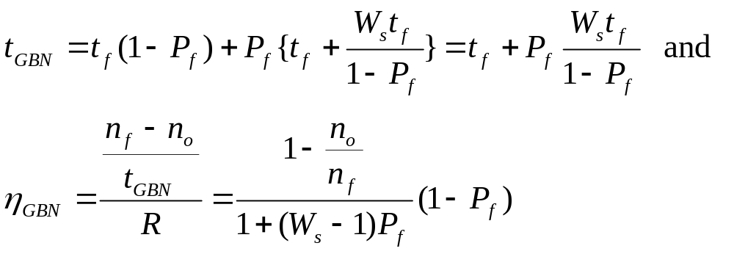
Efficiency of Go-Back-N
GBN is completely efficient, if W_{s} large enough to keep channel busy, and if channel is error-free
Assume P_{f} frame loss probability, then time to deliver a frame is:
  t_{f} if first frame transmission succeeds (1 – P_{f} )
  t_{f} + W_{s}t_{f} /(1-P_{f}) if the first transmission does not succeed P_{f}
Delay-bandwidth product determines W_{s}

Slide 70
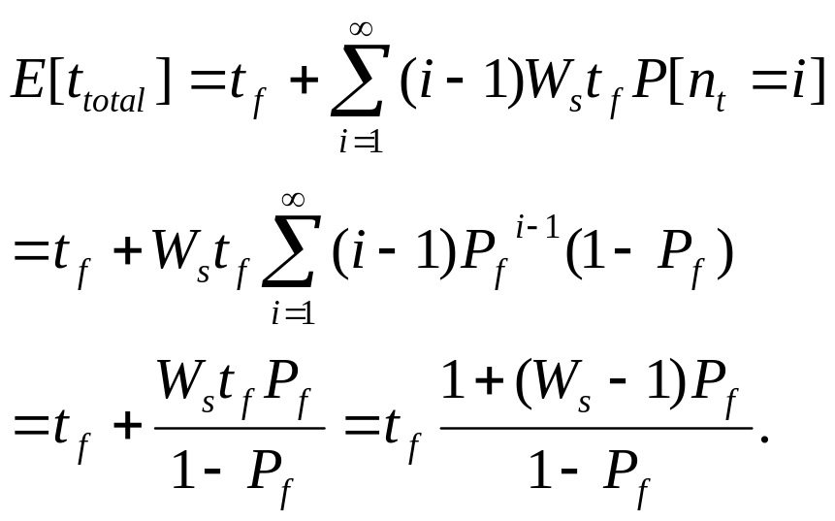
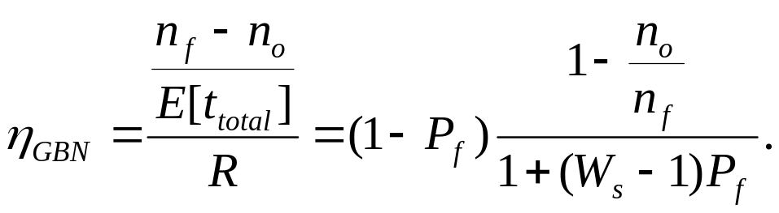
Go-Back-N Performance
1 successful transmission
i – 1 unsuccessful transmissions
Efficiency:

Slide 71
Example: Impact Bit Error Rate on GBN
n_{f}=1250 bytes = 10000 bits, n_{a}=n_{o}=25 bytes = 200 bits
Compare S&W with GBN efficiency for random bit errors with p = 0, 10⁻⁶, 10⁻⁵, 10⁻⁴ and R = 1 Mbps & 100 ms
1 Mbps x 100 ms = 100000 bits = 10 frames → Use W_{s} = 11
Efficiency | 0 | 10⁻⁶ | 10⁻⁵ | 10⁻⁴
S&W | 8.9% | 8.8% | 8.0% | 3.3%
GBN | 98% | 88.2% | 45.4% | 4.9%
Go-Back-N significant improvement over Stop-and-Wait for large delay-bandwidth product
Go-Back-N becomes inefficient as error rate increases

Slide 72
Selective Repeat ARQ
Go-Back-N ARQ inefficient because multiple frames are resent when errors or losses occur
Selective Repeat retransmits only an individual frame
  Timeout causes individual corresponding frame to be resent
  NAK causes retransmission of oldest un-acked frame
Receiver maintains a receive window of sequence numbers that can be accepted
  Error-free, but out-of-sequence frames with sequence numbers within the receive window are buffered
  Arrival of frame with R_{next} causes window to slide forward by 1 or more

Slide 73
Selective Repeat ARQ
fr
0
fr
1
fr
2
fr
3
fr
4
fr
5
fr
6
fr
2
fr
7
fr
8
fr
9
fr
10
fr
11
fr
12
Time
A
B
ACK1
ACK2
NAK2
ACK2
ACK2
ACK2
ACK7
ACK8
ACK9
ACK10
ACK11
ACK12

Slide 74
Selective Repeat ARQ
Transmitter
Receiver
Send Window
Receive Window
...
Frames
transmitted
and ACKed
Frames
received
S_{last}
S_{recent}
S_{last}+ W_{s}-1
R_{next}
R_{next} + W_{r}-1
Buffers
Buffers
Timer
S_{last}
R_{next}+ 1
Timer
S_{last}+ 1
R_{next}+ 2
...
S_{recent}
...
Timer
R_{next}+ W_{r}- 1
max Seq # accepted
...
S_{last}+ W_{s} - 1

Slide 75
Send & Receive Windows
Transmitter
Receiver
0
0
2^{m}-1
1
2^{m}-1
1
2
2
R_{next}
S_{last}
send
window
receive
window
j
i
i
i + W_{s} – 1
i + 1
j + W_{r} – 1
Moves k forward when ACK
arrives with R_{next} = S_{last} + k
k = 1, …, W_{s}-1
Moves forward by 1 or more when frame arrives with Seq. # = R_{next}

Slide 76
What size W_{s} and W_{r} allowed?
Example: M=2²=4, W_{s}=3, W_{r}=3
Frame 0 resent
Send Window
{0,1,2}
{1,2}
{2}
{.}
A
fr0
fr1
fr2
fr0
Time
B
Receive Window
ACK1
ACK2
ACK3
{0,1,2}
{1,2,3}
{2,3,0}
{3,0,1}
Old frame 0 accepted as a
new frame because it falls
in the receive window

Slide 77
W_{s} + W_{r} = 2^{m} is maximum allowed
Example: M=2²=4, W_{s}=2, W_{r}=2
Frame 0 resent
Send Window
{0,1}
{1}
{.}
A
fr0
fr1
fr0
Time
B
Receive Window
ACK1
ACK2
{0,1}
{1,2}
{2,3}
Old frame 0 rejected because it falls outside the receive window

Slide 78
Why W_{s} + W_{r} = 2^{m} works
Transmitter sends frames 0 to Ws-1; send window empty
All arrive at receiver
All ACKs lost
Receiver window starts at {0, …, W_{r}-1}
Window slides forward to {W_{s},…,W_{s}+W_{r}-1}
Receiver rejects frame 0 because it is outside receive window
Transmitter resends frame 0
0
0
2^{m}-1
1
2^{m}-1
1
S_{last}
W_{s} +W_{r}-1
2
2
receive
window
R_{next}
W_{s}
send
window
W_{s}-1

Slide 79
Applications of Selective Repeat ARQ
TCP (Transmission Control Protocol): transport layer protocol uses variation of selective repeat to provide reliable stream service
Service Specific Connection Oriented Protocol: error control for signaling messages in ATM networks

Slide 80
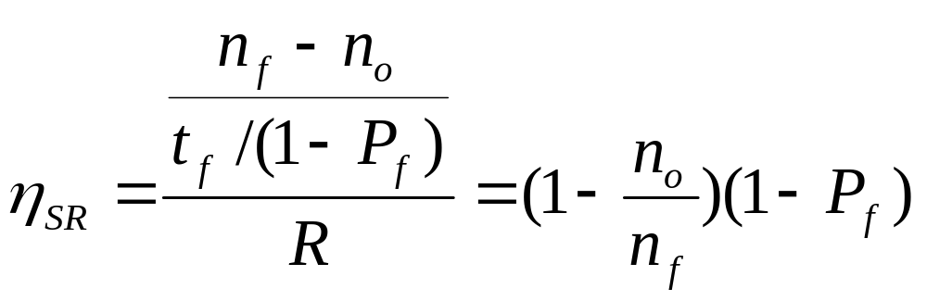
Efficiency of Selective Repeat
Assume P_{f} frame loss probability, then number of transmissions required to deliver a frame is:
  t_{f} / (1-P_{f})

Slide 81
Example: Impact Bit Error Rate on Selective Repeat
n_{f}=1250 bytes = 10000 bits, n_{a}=n_{o}=25 bytes = 200 bits
Compare S&W, GBN & SR efficiency for random bit errors with p=0, 10⁻⁶, 10⁻⁵, 10⁻⁴ and R= 1 Mbps & 100 ms
Efficiency | 0 | 10⁻⁶ | 10⁻⁵ | 10⁻⁴
S&W | 8.9% | 8.8% | 8.0% | 3.3%
GBN | 98% | 88.2% | 45.4% | 4.9%
SR | 98% | 97% | 89% | 36%
Selective Repeat outperforms GBN and S&W, but efficiency drops as error rate increases

Slide 82
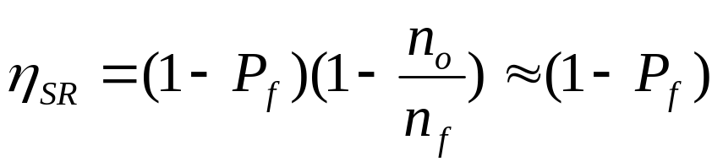
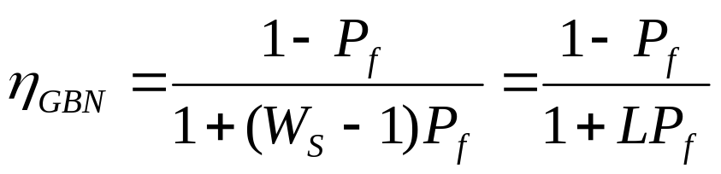
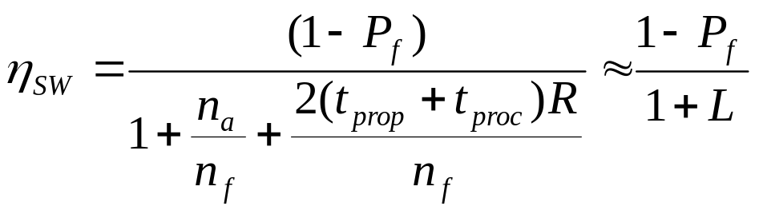
Comparison of ARQ Efficiencies
Assume n_{a} and n_{o} are negligible relative to n_{f}, and
L = 2(t_{prop}+t_{proc})R/n_{f} =(W_{s}-1), then
Selective-Repeat:
Go-Back-N:
For P_{f}≈0, SR & GBN same
For P_{f}→1, GBN & SW same
Stop-and-Wait:

Slide 83
ARQ Efficiencies
ARQ Efficiency Comparison
Selective
1.5
Repeat
Go Back N 10
1
Efficiency
0.5
Stop and Wait
10
0
Go Back N 100
-9
-8
-7
-6
-5
-4
-3
-2
-1
10⁻⁹ 10⁻⁸ 10⁻⁷ 10⁻⁶ 10⁻⁵ 10⁻⁴ 10⁻³ 10⁻² 10⁻¹
LOG(p)
Stop and Wait
p
100
Delay-Bandwidth product = 10, 100

Slide 84
Chapter 5
Peer-to-Peer Protocols and Data Link Layer
PART I: Peer-to-Peer Protocols
Peer-to-Peer Protocols
ARQ Protocols and Reliable Data Transfer
Flow Control

Slide 85
Pacing and Flow Control
Messages can be lost if receiving system does not have sufficient buffering to store arriving messages
If destination layer-(n+1) does not retrieve its information fast enough, destination layer-n buffers may overflow
Pacing & Flow Control provide backpressure mechanisms that control transfer according to availability of buffers at the destination
Examples: TCP and HDLC

Slide 86
Flow Control
buffer fill
Information frame
Transmitter
Receiver
Control frame
Receiver has limited buffering to store arriving frames
Several situations cause buffer overflow
  Mismatch between sending rate & rate at which user can retrieve data
  Surges in frame arrivals
Flow control prevents buffer overflow by regulating rate at which source is allowed to send information

Slide 87
X ON / X OFF
threshold
Information frame
Transmitter
Receiver
Transmit
X OFF
Transmit
Time
A
on
off
on
off
B
Time
2T_{prop}
Threshold must activate OFF signal while 2 T_{prop} R bits still remain in buffer

Slide 88
Window Flow Control
Return of permits
t_{cycle}
A
Time
B
Time
Sliding Window ARQ method with W_{s} equal to buffer available
  Transmitter can never send more than W_{s} frames
ACKs that slide window forward can be viewed as permits to transmit more
Can also pace ACKs as shown above
  Return permits (ACKs) at end of cycle regulates transmission rate

Slide 89
Chapter 5
Peer-to-Peer Protocols and Data Link Layer
PART II: Data Link Controls
Framing
Point-to-Point Protocol
High-Level Data Link Control

Slide 90
Data Link Protocols
Packets
Packets
Data Links Services
Framing
Error control
Flow control
Multiplexing
Link Maintenance
Security: Authentication & Encryption
Examples
PPP
HDLC
Ethernet LAN
IEEE 802.11 (Wi Fi) LAN
Data link
layer
Data link
layer
A
Frames
Physical
layer
B
Physical
layer
Directly connected, wire-like
Losses & errors, but no out-of-sequence frames
Applications: Direct Links; LANs; Connections across WANs

Slide 91
Framing
Mapping stream of physical layer bits into frames
Mapping frames into bit stream
Frame boundaries can be determined using:
  Character Counts
  Control Characters
  Flags
  CRC Checks
transmitted
frames
received
frames
Framing
0111110101
0110110111

Slide 92
Character-Oriented Framing
Data to be sent
A
DLE
B
ETX
DLE
STX
E
After stuffing and framing
DLE
STX
A
DLE
DLE
B
ETX
DLE
DLE
STX
E
DLE
ETX
Frames consist of integer number of bytes
  Asynchronous transmission systems using ASCII to transmit printable characters
  Octets with HEX value <20 are nonprintable
Special 8-bit patterns used as control characters
  STX (start of text) = 0x02; ETX (end of text) = 0x03;
Byte used to carry non-printable characters in frame
  DLE (data link escape) = 0x10
  DLE STX (DLE ETX) used to indicate beginning (end) of frame
  Insert extra DLE in front of occurrence of DLE in frame – byte stuffing
  All DLEs occur in pairs except at frame boundaries

Slide 93
Framing & Bit Stuffing
HDLC frame
Flag
Address
Control
Information
FCS
Flag
any number of bits
Frame delineated by flag character
HDLC uses bit stuffing to prevent occurrence of flag 01111110 inside the frame
Transmitter inserts extra 0 after each consecutive five 1s inside the frame
Receiver checks for five consecutive 1s
  if next bit = 0, it is removed
  if next two bits are 10, then flag is detected
  If next two bits are 11, then frame has errors

Slide 94
Example: Bit stuffing & de-stuffing
(a)
Data to be sent
0110111111111100
After stuffing and framing
0111111001101111101111100001111110
(b)
Data received
01111110000111011111011111011001111110
After destuffing and deframing
*000111011111-11111-110*

Slide 95
Chapter 5
Peer-to-Peer Protocols and Data Link Layer
PART II: Data Link Controls
Framing
Point-to-Point Protocol
High-Level Data Link Control

Slide 96
PPP: Point-to-Point Protocol
Data link protocol for point-to-point lines in Internet
  Router-router; dial-up to router
1. Provides Framing and Error Detection
  Character-oriented HDLC-like frame structure
2. Link Control Protocol (LCP)
  Bringing up, testing, bringing down lines; negotiating options
  Authentication: key capability in ISP access
3. A family of Network Control Protocols (NCP) specific to different network layer protocols
  IP, OSI network layer, IPX (Novell), Appletalk

Slide 97
PPP Applications
PPP used in many point-to-point applications
Telephone Modem Links 30 kbps
Packet over SONET 600 Mbps to 10 Gbps
  IP→PPP→SONET
PPP is also used over shared links such as Ethernet to provide LCP, NCP, and authentication features
  PPP over Ethernet (RFC 2516)
  Used over DSL

Slide 98
PPP Frame
Flag
Address
Control
Protocol
Information
CRC
Flag
01111110
1111111
00000011
01111110
integer # of bytes
All stations are to
accept the frame
Unnumbered frame
Specifies what kind of packet is contained in the payload, e.g., LCP, NCP, IP, OSI CLNP, IPX
PPP uses similar frame structure as HDLC, except
  Protocol type field
  Payload contains an integer number of bytes
PPP uses the same flag, but uses byte stuffing

Slide 99
Byte-Stuffing in PPP
PPP is character-oriented version of HDLC
Flag is 0x7E (01111110)
Control escape 0x7D (01111101)
Any occurrence of flag or control escape inside of frame is replaced with 0x7D followed by
original octet XORed with 0x20 (00100000)
Data to be sent
41
7D
42
7E
50
70
46
7E
41
7D
5D
42
7D
5E
50
70
46
7E
After stuffing and framing

Slide 100
PPP Phases
1. Carrier
detected
Home PC to Internet Service Provider
1. PC calls router via modem
2. PC and router exchange LCP packets to negotiate PPP parameters
3. Check on identities
4. NCP packets exchanged to configure the network layer, e.g. TCP/IP ( requires IP address assignment)
5. Data transport, e.g. send/receive IP packets
6. NCP used to tear down the network layer connection (free up IP address); LCP used to shut down data link layer connection
7. Modem hangs up
Dead
7. Carrier
dropped
Failed
Terminate
Establish
2. Options
negotiated
6. Done
Failed
5.
Open
Authenticate
3. Authentication
completed
4. NCP
configuration
Network

Slide 101
PPP Authentication
Password Authentication Protocol
  Initiator must send ID & password
  Authenticator replies with authentication success/fail
  After several attempts, LCP closes link
  Transmitted unencrypted, susceptible to eavesdropping
Challenge-Handshake Authentication Protocol (CHAP)
  Initiator & authenticator share a secret key
  Authenticator sends a challenge (random # & ID)
  Initiator computes cryptographic checksum of random # & ID using the shared secret key
  Authenticator also calculates cryptocgraphic checksum & compares to response
  Authenticator can reissue challenge during session

Slide 102
Chapter 5
Peer-to-Peer Protocols and Data Link Layer
PART II: Data Link Controls
Framing
Point-to-Point Protocol
High-Level Data Link Control

Slide 103
High-Level Data Link Control (HDLC)
Bit-oriented data link control
Derived from IBM Synchronous Data Link Control (SDLC)
Related to Link Access Procedure Balanced (LAPB)
  LAPD in ISDN
  LAPM in cellular telephone signaling

Slide 104
HDLC Data Transfer Modes
Normal Response Mode
  Used in polling multidrop lines
Commands
Primary
Responses
Secondary
Secondary
Secondary
Asynchronous Balanced Mode
  Used in full-duplex point-to-point links
Primary
Commands
Responses
Secondary
Secondary
Responses
Commands
Primary
Mode is selected during connection establishment

Slide 105
HDLC Frame Format
Flag
Address
Control
Information
FCS
Flag
Control field gives HDLC its functionality
Codes in fields have specific meanings and uses
  Flag: delineate frame boundaries
  Address: identify secondary station (1 or more octets)
    In ABM mode, a station can act as primary or secondary so address changes accordingly
  Control: purpose & functions of frame (1 or 2 octets)
  Information: contains user data; length not standardized, but implementations impose maximum
  Frame Check Sequence: 16- or 32-bit CRC

Slide 106
Control Field Format
Information Frame
1
2-4
5
6-8
0
N(S)
P/F
N(R)
Supervisory Frame
1
0
S
S
P/F
N(R)
Unnumbered Frame
1
1
M
M
P/F
M
M
M
S: Supervisory Function Bits
N(R): Receive Sequence Number
N(S): Send Sequence Number
M: Unnumbered Function Bits
P/F: Poll/final bit used in interaction between primary and secondary

Slide 107
Information frames
Each I-frame contains sequence number N(S)
Positive ACK piggybacked
  N(R)=Sequence number of next frame expected acknowledges all frames up to and including N(R)-1
3 or 7 bit sequence numbering
  Maximum window sizes 7 or 127
Poll/Final Bit
  NRM: Primary polls station by setting P=1; Secondary sets F=1 in last I-frame in response
  Primaries and secondaries always interact via paired P/F bits

Slide 108
Error Detection & Loss Recovery
Frames lost due to loss-of-synch or receiver buffer overflow
Frames may undergo errors in transmission
CRCs detect errors and such frames are treated as lost
Recovery through ACKs, timeouts & retransmission
Sequence numbering to identify out-of-sequence & duplicate frames
HDLC provides for options that implement several ARQ methods

Slide 109
Supervisory frames
Used for error (ACK, NAK) and flow control (Don’t Send):
Receive Ready (RR), SS=00
  ACKs frames up to N(R)-1 when piggyback not available
REJECT (REJ), SS=01
  Negative ACK indicating N(R) is first frame not received correctly. Transmitter must resend N(R) and later frames
Receive Not Ready (RNR), SS=10
  ACKs frame N(R)-1 & requests that no more I-frames be sent
Selective REJECT (SREJ), SS=11
  Negative ACK for N(R) requesting that N(R) be selectively retransmitted

Slide 110
Unnumbered Frames
Setting of Modes:
  SABM: Set Asynchronous Balanced Mode
  UA: acknowledges acceptance of mode setting commands
  DISC: terminates logical link connection
Information Transfer between stations
  UI: Unnumbered information
Recovery used when normal error/flow control fails
  FRMR: frame with correct FCS but impossible semantics
  RSET: indicates sending station is resetting sequence numbers
XID: exchange station id and characteristics

Slide 111
Connection Establishment & Release
Unnumbered frames used to establish and release data link connection
In HDLC
  Set Asynchronous Balanced Mode (SABM)
  Disconnect (DISC)
  Unnumbered Acknowledgment (UA)
SABM
Data
transfer
UA
UA
DISC

Slide 112
Example: HDLC using NRM (polling)
Address of secondary
Primary A
Secondaries B, C
A polls B
B, RR, 0, P
N(S)
N(R)
B, I, 0, 0
B sends 3 info
frames
N(R)
B, I, 1, 0
X
B, I, 2, 0,F
A rejects fr1
B, SREJ, 1
A polls C
C, RR, 0, P
C, RR, 0, F
C nothing to send
A polls B, requests
selective retrans. fr1
B, SREJ, 1,P
B, I, 1, 0
B resends fr1
Then fr 3 & 4
B, I, 3, 0
B, I, 4, 0, F
A send info fr0
to B, ACKs up to 4
B, I, 0, 5
Time

Slide 113
Frame Exchange using Asynchronous Balanced Mode
Combined Station A
Combined Station B
B, I, 0, 0
A, I, 0, 0
B, I, 1, 0
A, I, 1, 1
B ACKs fr0
X
A sends 5 frames
B, I, 2, 1
A, I, 2, 1
B, I, 3, 2
B rejects fr1
B, REJ, 1
B, I, 4, 3
A, I, 3, 1
A goes back to 1
B, I, 1, 3
B, I, 2, 4
B, RR, 2
B ACKs fr1
B, I, 3, 4
B, RR, 3
B ACKs fr2

Slide 114
Flow Control
Flow control is required to prevent transmitter from overrunning receiver buffers
Receiver can control flow by delaying acknowledgement messages
Receiver can also use supervisory frames to explicitly control transmitter
  Receive Not Ready (RNR) & Receive Ready (RR)
I3
I4
I5
RNR5
RR6
I6

